Slide 1
PARALLEL COMPUTING
MPI Programming and Parallel Algorithms
Distributed Memory Programming • Collective Communication • Performance Evaluation

Slide 2
Learning Objectives
Understand distributed-memory programming with MPI
Explain the trapezoidal rule using MPI
Understand MPI I/O and collective communication
Evaluate MPI program performance
Understand parallel sorting algorithms
Explain MPI-derived datatypes

Slide 3
MODULE 3
Distributed memory programming with MPI
MPI functions
The trapezoidal rule in MPI-Dealing with I/O,Collective communication,
Performance evaluation of MPI programs
A parallel sorting algorithm.
MPI-derived datatypes

Slide 4
DEFINITION
Distributed memory programming with MPI divides a computation among multiple processes, where each process has its own memory, and processes communicate with each other by explicitly sending and receiving messages.
Distributed memory programming is a method of parallel programming where each processor has its own private memory. Processors cannot directly access another processor's memory. They communicate by sending and receiving messages.
WHY?
To make things easier, let’s directly jump to some statistics:
Facebook, currently, has 1.5 billion active monthly users.
Google performs at least 1 trillion searches per year.
About 48 hours of video are uploaded on Youtube every minute.
With such high demand, a single system would be unable to handle the processing. Thus, comes the need for Distributed Systems.

Slide 5
A distributed system consists of a collection of autonomous computers, connected through a network and distribution middleware, which enables computers to coordinate their activities and to share the resources of the system so that users perceive the system as a single, integrated computing facility.
EXAMPLE:Google Web Server, from users perspective while they submit the searched query, they assume google web server as a single system. However, behind the curtain, Google has built a lot of servers which is distributed (geographically and computationally) to give us the result within a few seconds.
Advantages of Distributed Computing?
Highly efficient
Scalability
Less tolerant of failures
High Availability
An example where we save computational time by using distributed computing.

Slide 6
Examples :
If we have an array, a, having n elements, a=[1, 2, 3, 4, 5, 6]
We want to sum up all the elements of the array and output it. Now, let us assume that there are 10²⁰ elements in the array and the time to compute the sum is x.
If we now divide the array in 3 parts, a1, a2 and a3 where a1 = { Set of elements where modulo(element from a) == 0 } a2 = { Set of elements where modulo(element from a) == 1 } a3 = { Set of elements where modulo(element from a) == 2 }
We will send these 3 arrays to 3 different processes for computing the sum of these individual processes. On average, let’s assume that each array has n/3 elements. Thus, the time taken by each process will also reduce to x/3. Since these processes will be running in parallel, the three “x/3” will be computed simultaneously and the sum of each array is returned to the main process. In the end, we can compute the final sum of a by summing up the individual sum of the arrays: a1, a2, and a3.
Thus, we are able to reduce the time from x to x/3, if we are running the process simultaneously.

Slide 7
Message Passing Interface (MPI) is a standardized and portable message-passing system developed for distributed and parallel computing. MPI provides parallel hardware vendors with a clearly defined base set of routines that can be efficiently implemented.
MPI = Message Passing Interface
MPI is a standard/library for writing parallel programs that run on distributed-memory systems.
MPI provides functions for:
Sending messages
Receiving messages
Communicating among processes
Synchronizing processes
Dividing work among processes
MPI is commonly used in:
High Performance Computing (HPC)
Supercomputers
Computer clusters
Scientific simulations
Large-scale numerical computations

Slide 8
3. How MPI works
When an MPI program starts, multiple processes are created.
For example:
3. How MPI works
Each process gets a unique number called its rank.
For 4 processes:
Process | Rank
Process 0 | 0
Process 1 | 1
Process 2 | 2
Process 3 | 3
4.MPI communicationThe most basic communication is:SendOne process sends data:Process 0 ─────── message ───────> Process 1
ReceiveThe other process receives the data:Process 1 receives the message
Conceptually:

Slide 9
Process 0 Process 1
│ │
│ "Hello" │
├────────────────────────────>│
│ │
Send Receive
MPI provides functions such as:MPI_Send() → send dataMPI_Recv() → receive data
5. Important MPI functionsMPI_Init()Starts the MPI environment.
MPI_Comm_size() \\Gets the total number of processes.
MPI_Comm_size(MPI_COMM_WORLD, &size);
For example, if 4 processes are running:
size = 4
MPI_Comm_rank()\\Gets the rank of the current process.
MPI_Comm_rank(MPI_COMM_WORLD, &rank);

Slide 10
The value could be:
rank = 0
rank = 1
rank = 2
rank = 3
depending on which process is executing the statement.
\\MPI_Send()
\\Sends a message.
MPI_Send(data, count, datatype, destination, tag, communicator);
\\MPI_Recv()
MPI_Recv(data, count, datatype, source, tag, communicator, &status);
\\MPI_Finalize()
\\Terminates the MPI environment.
MPI_Finalize();

Slide 11
6. Simple example
if (rank == 0) {
int number = 100;
MPI_Send(&number, 1, MPI_INT, 1, 0, MPI_COMM_WORLD);
}
if (rank == 1) {
int number;
MPI_Recv(&number, 1, MPI_INT, 0, 0,
MPI_COMM_WORLD, MPI_STATUS_IGNORE);
}
Here:
rank == 0 → sender
rank == 1 → receiver100 → message1 → destination rank0 → source rank in MPI_Recv()

Slide 12
Suppose Process 0 wants to send the number 100 to Process 1.
Process 0 Process 1
│ │
│ 100 │
├─────────────────────────────────>│
│ │
MPI_Send() MPI_Recv()
Conceptually:
if (rank == 0) {
int number = 100;
MPI_Send(&number, 1, MPI_INT, 1, 0, MPI_COMM_WORLD);
}
if (rank == 1) {
int number;
MPI_Recv(&number, 1, MPI_INT, 0, 0,
MPI_COMM_WORLD, MPI_STATUS_IGNORE);
}

Slide 13
Here:
rank == 0 → sender
rank == 1 → receiver
100 → message
1 → destination rank
0 → source rank in MPI_Recv()
7. Why is MPI called distributed-memory programming?
Because memory is physically distributed among different processes/nodes.
Shared memory
Shared Memory
┌─────────────────┐
│ Memory │
└─────────────────┘ All processors can access the same memory.
↑ ↑ ↑
P0 P1 P2
Distributed memory
P0 P1 P2
┌─────┐ ┌─────┐ ┌─────┐
│Mem 0│ │Mem 1│ │Mem 2│
└─────┘ └─────┘ └─────┘
│ │ │
└──────── Network ────────────┘Each processor has its own memory.

Slide 14
8. Example: Adding numbers using MPI
Suppose we want to calculate:
1 + 2 + 3 + 4 + 5 + 6 + 7 + 8
Using 4 processes, we can divide the work:
Process 0 → 1 + 2
Process 1 → 3 + 4
Process 2 → 5 + 6
Process 3 → 7 + 8
Each process calculates its local sum:
P0 → 3
P1 → 7
P2 → 11
P3 → 15
Then the results are combined:
3 + 7 + 11 + 15 = 36

Slide 15
So:
MPI Program
│
┌─────────┼─────────┐
↓ ↓ ↓
P0 P1 P2 P3
1+2 3+4 5+6 7+8
↓ ↓ ↓ ↓
3 7 11 15
└─────────┴─────────┴─────────┘
↓
36
MPI provides a convenient operation called MPI_Reduce() to perform this type of combination.

Slide 16
9. Advantages of MPI
High performanceSuitable for large parallel computations.
2. ScalableCan run on a small number of processors or thousands of processors.
3. Works across multiple computersMPI programs can run on a cluster.
4. Explicit communication The programmer controls how and when data is exchanged.
5. Suitable for distributed systems
6.Each computer can have its own memory and processor.
Disadvantages
1.Programming is more complex than shared-memory programming.
2.Programmer must manage communication.
3.Communication between processes introduces latency.
4.Sending large amounts of data can reduce performance.
5.Debugging parallel MPI programs can be difficult.

Slide 17
11. Key terms to remember
Term | Meaning
MPI | Message Passing Interface
Process | Independent execution unit
Rank | Unique ID of an MPI process
Communicator | Defines a group of processes that can communicate
MPI_COMM_WORLD | Default communicator containing all MPI processes
Send | Sending data from one process to another
Receive | Receiving data from another process
Point-to-point communication | Communication between two processes
Collective communication | Communication involving a group of processes
Distributed memory | Each process has its own private memory

Slide 18
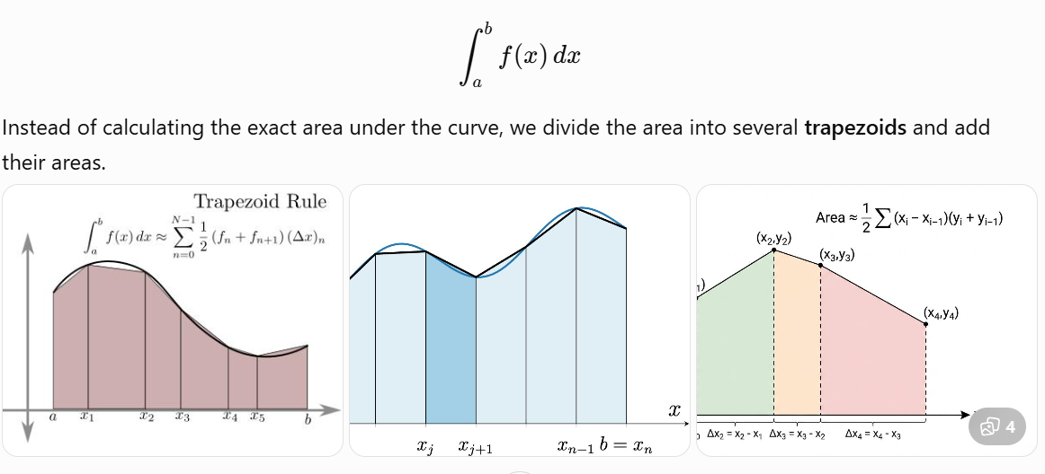
The Trapezoidal Rule in MPI
The trapezoidal rule is a numerical method used to approximate the definite integral of a function.
For example:

Slide 19
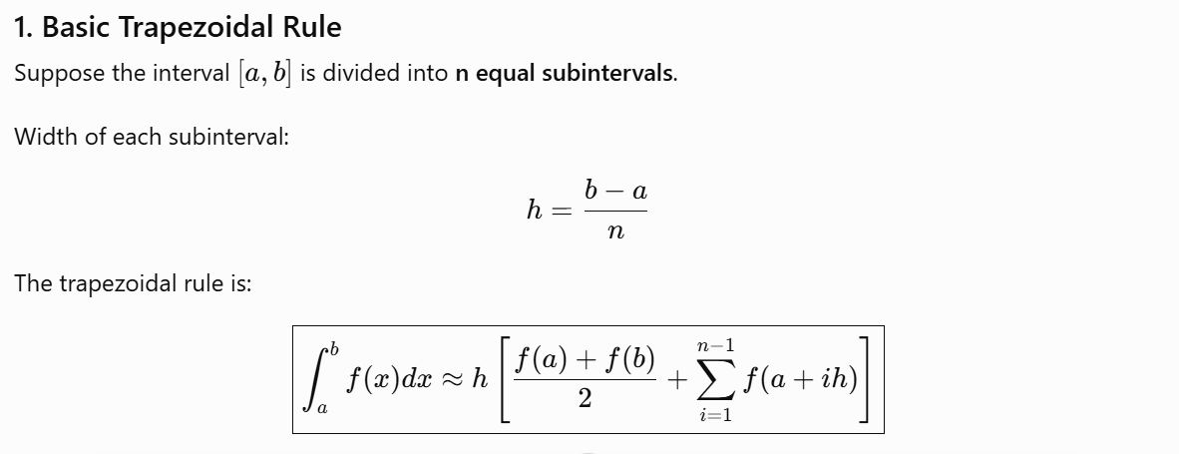
The trapezoidal rule in MPI divides the interval of integration among multiple processes. Each process calculates the area of the trapezoids in its assigned portion, and MPI combines all the local results to obtain the final integral.

Slide 20
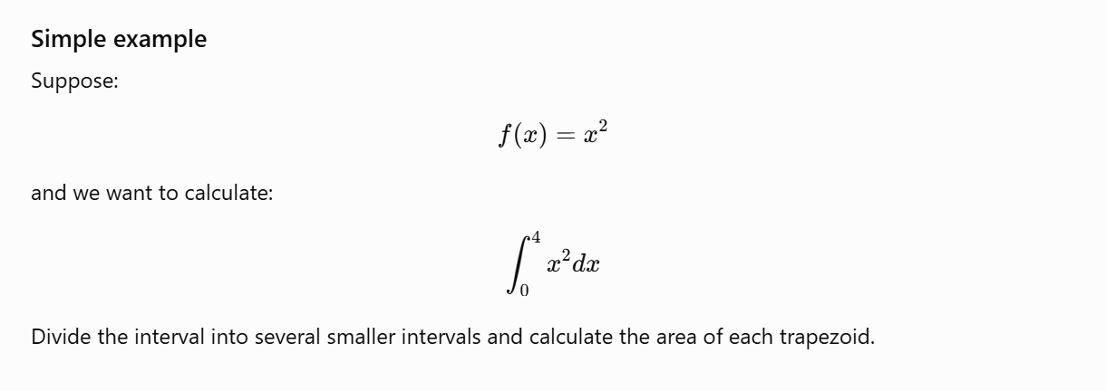

Slide 21
2. Why use MPI?
For a large value of n, calculating all the values of f(x) can take a lot of time.
MPI allows us to divide the work among multiple processes.
For example, with 4 processes:
Entire interval [a,b]
│
┌────────────┼────────────┐
↓ ↓ ↓
Process 0 Process 1 Process 2 Process 3
Part 1 Part 2 Part 3 Part 4
│ │ │ │
Local sum Local sum Local sum Local sum
│ │ │ │
└────────────┴─────────────┴────────────┘
↓
Global sum
↓
Final integral
Each process calculates the trapezoidal sum for its own portion of the interval.

Slide 22
3. MPI Approach
The main steps are:
Step 1: Start MPI
MPI_Init(NULL, NULL);
Step 2: Find number of processes
MPI_Comm_size(MPI_COMM_WORLD, &comm_sz);
For example:
comm_sz = 4
means there are 4 processes.
Step 3: Find the rank
MPI_Comm_rank(MPI_COMM_WORLD, &my_rank);
Ranks will be:
0, 1, 2, 3
Step 4: Divide the interval
Each process gets a portion of the interval.
If there are:

Slide 23
n = 1000 trapezoids
p = 4 processes
then approximately:
Process 0 → 250 trapezoids
Process 1 → 250 trapezoids
Process 2 → 250 trapezoids
Process 3 → 250 trapezoids
Step 5: Calculate local integral
Each process calculates its own local integral.
Step 6: Combine the results
The local results are added together using:
Step 5: Calculate local integral
Each process calculates its own local integral.
Step 6: Combine the results
The local results are added together using:
MPI_Reduce()

Slide 24
For example:
Process 0 → 2.5
Process 1 → 3.1
Process 2 → 4.2
Process 3 → 5.2
↓
MPI_Reduce()
↓
15.0
Step 7: Finish MPI
MPI_Finalize();

Slide 25
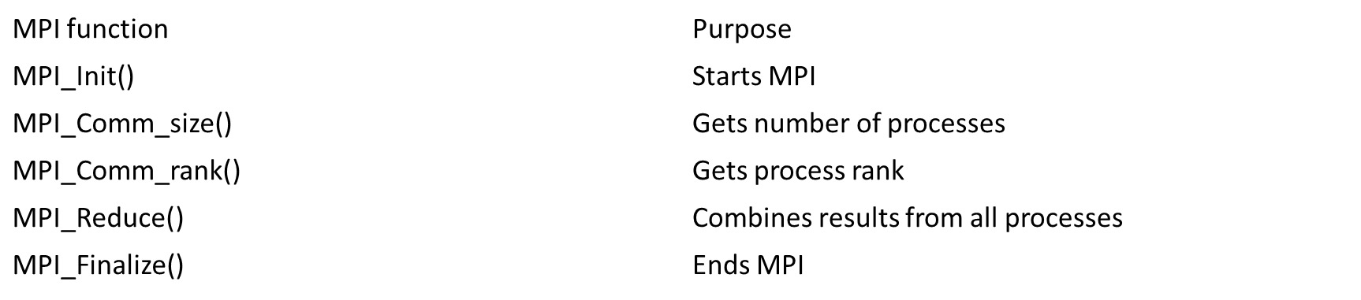
4. Important MPI functions

Slide 26
5. Main idea of the algorithm
The serial version does:
Calculate f(x) for all points
↓
Calculate all trapezoid areas
↓
Add all areas
↓
Final integral

Slide 27
The MPI version does:
Total work
↓
┌───────────┼───────────┐
↓ ↓ ↓
P0 P1 P2 P3
↓ ↓ ↓ ↓
Local Local Local Local
sum sum sum sum
└───────────┬───────────┘
↓
MPI_Reduce
↓
Final result

Slide 28
Distributed Memory Programming with MPI
Each process has its own private memory
Processes communicate by sending and receiving messages
MPI = Message Passing Interface
Common in clusters and high-performance computing
Each process is identified by a unique rank

Slide 29
MPI Process Model
MPI program starts multiple processes
MPI_Comm_size() → total number of processes
MPI_Comm_rank() → rank of current process
MPI_COMM_WORLD → default communicator
MPI_Send() and MPI_Recv() support point-to-point communication

Slide 30
Basic MPI Program Structure
MPI_Init() → start MPI environment
MPI_Comm_size() → obtain number of processes
MPI_Comm_rank() → obtain process rank
Perform parallel computation and communication
MPI_Finalize() → terminate MPI environment

Slide 31
The Trapezoidal Rule
Numerically approximates a definite integral
Divide interval [a,b] into n equal subintervals
h = (b − a) / n
Compute the area of each trapezoid
Add all areas to obtain the approximate integral

Slide 32
Trapezoidal Rule in MPI
Divide the integration interval among processes
Each process computes a local integral
Local results are combined using MPI_Reduce()
Rank 0 can report the final result
Parallelism reduces computation time for large n

Slide 33
Dealing with I/O in MPI
I/O = Input/Output
Uncoordinated simultaneous output can be confusing and slow
A common approach is to let rank 0 handle common input/output
For very large datasets, MPI supports parallel/distributed I/O
Minimize unnecessary file access and communication

Slide 34
Collective Communication
Communication involving a group of processes
MPI_Bcast() → one process broadcasts data to all
MPI_Scatter() → distributes different portions of data
MPI_Gather() → collects data from processes
MPI_Reduce() → combines values at a root process
MPI_Allreduce() → combines and makes result available to all
MPI_Barrier() → synchronizes processes

Slide 35
MPI_Reduce in Trapezoidal Rule
Each process calculates a local sum
MPI_Reduce() combines local sums
Typical operation: MPI_SUM
Result can be placed at root process
Useful for global totals such as the final integral

Slide 36
Performance Evaluation of MPI Programs
Measure execution time using MPI_Wtime()
Speedup: Sₚ = T₁ / Tₚ
Efficiency: Eₚ = Sₚ / p
Evaluate scalability as process count increases
Consider communication overhead and synchronization
Check load balancing among processes

Slide 37
Communication Overhead and Load Balancing
Communication includes message transfer and synchronization
Latency affects the start of communication
Bandwidth affects the rate of data transfer
Good load balancing gives each process similar work
Too much communication or imbalance can reduce speedup

Slide 38
Parallel Sorting Algorithm
Divide unsorted data among processes
Each process sorts its local portion
Collect or exchange sorted portions
Merge the sorted portions to obtain the final sorted sequence
MPI_Scatter() and MPI_Gather() can support the data distribution and collection

Slide 39
Parallel Sorting Example
Input: [8, 3, 7, 2, 6, 1, 5, 4]
P0 → [8,3] → [3,8]
P1 → [7,2] → [2,7]
P2 → [6,1] → [1,6]
P3 → [5,4] → [4,5]
Final merged result: [1,2,3,4,5,6,7,8]

Slide 40
MPI-Derived Datatypes
Allow complex data layouts to be described as one MPI datatype
Useful for non-contiguous data and mixed data types
Can reduce repeated communication and manual packing
Examples: contiguous, vector, indexed, and struct datatypes

Slide 41
Common Derived Datatype Functions
MPI_Type_contiguous() → consecutive elements
MPI_Type_vector() → regularly spaced elements
MPI_Type_indexed() → irregularly spaced elements
MPI_Type_create_struct() → mixed fields/types
MPI_Type_commit() → make datatype ready for use
MPI_Type_free() → release the datatype

Slide 42
Key Takeaways
MPI enables distributed-memory parallel programming
Trapezoidal integration demonstrates parallel numerical computation
Collective communication coordinates groups of processes
Performance depends on time, speedup, efficiency, communication and load balance
Parallel sorting divides sorting work across processes
Derived datatypes simplify communication of complex memory layouts

